Slide 1
TSST Strand I
UNIT I2: Trigonometric Problems

Slide 2
Strand I
Unit I2
Trigonometric Problems
This units looks at problems where we are given less information about triangles and moves on to look at finding the lengths of sides and size of angles in any triangle (not just right-angled triangles).
You have four sections to work through and there are check up audits and fitness tests for each section
Mixed Problems using Trigonometry
Sine and Cosine Rules
Application: Area of Any Triangle
Heron's Formula

Slide 3
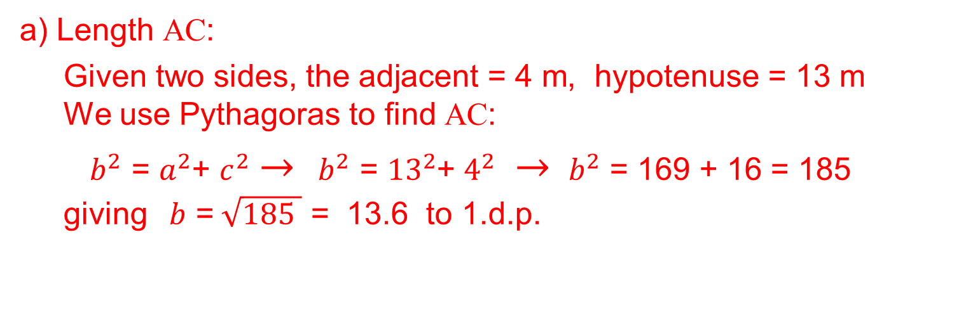
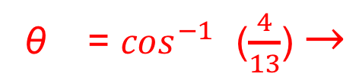
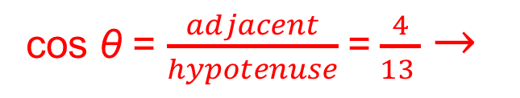
Strand I
Unit I2
Section I2.1
Mixed Problems using Trigonometry
Example
ABC is a right angled triangle. AB is of length 4 m and BC is of length 13 m.
Calculate the length of AC.
Calculate the size of angle ABC.
Solution
a) Length AC:
Given two sides, the adjacent = 4 m, hypotenuse = 13 m
We use Pythagoras to find AC:
$b^{2}$ = $a^{2}$+ $c^{2}$ $→$ ${ b}^{2}$ = ${13}^{2}$+ $4^{2}$ $→$ ${ b}^{2}$ = 169 + 16 = 185
giving $b$ =$\sqrt{185 }$ = 13.6 to 1.d.p.
b) Angle ABC:
cos θ = $\frac{adjacent}{hypotenuse}$ = $\frac{4}{13 }$ $→$
θ = $\cos^{−1}$ ($\frac{4}{13}$) $→$
θ = 72.1°to 1 d.p.

Slide 4
Strand I
Unit I2
Section I2.1
Section I2.1: Fitness Check
Here is a question to check your progress.
The diagram shows a roofing frame ABCD.
AB =7 m, BC=5 m, and
angle ABD = angle DBC = 90°
a) Calculate the length of AD.
b) Calculate the size of angle DCB.
Answers a) 7.62 (2 d.p.) b) 31 (1 d.p.)

Slide 5
STRAND I
Unit I2
Section I2.1
Section I2.1: Review
You have completed the first Section.
If you have completed and understood this section,
click to start the next Section.
If you need more examples and interactive practice, go to
http://szalonta.hu/ske/text/I2/skei2s1.html

Slide 6
STRAND I
Unit I2
Section I2.2
Sine and Cosine Rules
The sine and cosine rules are used to find a side or an angle in a triangle.
In the triangle ABC, the side opposite angle A has length a, the side opposite angle B has length b and the side opposite angle C has length c.
The sine rule states
The cosine rule states
$$a^{2}=b^{2}+c^{2}−2bc cos A$$
$$b^{2}=a^{2}+c^{2}−2ac cos B$$
$$c^{2}=a^{2}+b^{2}−2ab cos C$$
$$\frac{\sin{A}}{a}=\frac{sin B}{b}=\frac{\sin{C}}{c}$$
Note that when, for example A = ${90}^{0},$the formula becomes, as expected, Pythagoras’ Theorem: $a^{2}=b^{2}+c^{2}$

Slide 7
STRAND I
Unit I2
Section I2.2
Sine and Cosine Rules
The cosine rule can be used in any triangle to calculate:
a side when two sides and the angle in between them are known (SAS)
an angle when three sides are known (SSS)
The sine rule can be used in any triangle to calculate:
a side when two angles and an opposite side
are known (AAS)
an angle when two sides and an opposite angle are known (SSA)

Slide 8
STRAND I
Unit I2
Section I2.2
Sine Rule
Example 1
Find the unknown angles and side length of the triangle shown.
Solution
Using the sine rule
$\frac{\sin{A}}{2.1}=\frac{sin70°}{3.5}=\frac{\sin{B}}{b}$
From the first equality,
sin A = $\frac{ 2.1\sin{70°}}{3.5}$ $≈$ 0.5638
A $≈$ $34.32°$
Since angles in a triangle add up to 180 $°$
B = $180°−$ $70°$ $−$ $34.32°≈75.68°$
From the sine rule $\frac{sin70°}{3.5}=\frac{\sin{B}}{b}$
b = $\frac{3.5×sin{B}}{\sin{70°}}$ =
$\frac{3.5 × sin{75.68°}}{\sin{70°}}$ $≈$ 3.61 cm

Slide 9
STRAND I
Unit I2
Section I2.2
Sine Rule
Example 2
Find two solutions for the unknown angles and side of the triangle shown.
Solution
Using the sine rule:
$\frac{\sin{A}}{a}=\frac{sinB}{b}=\frac{\sin{C}}{c}$
From the second equality
sin B = $\frac{6 × sin{42°}}{5}≈$ 0.8030
A graph shows that there are two solutions for B between $0°$ and 180$°$
Solution continues on next slide

Slide 10
STRAND I
Unit I2
Section I2.2
Sine Rule
Solution (continued)
These solutions are
B = 53.41$°$ and by symmetry
B = 180$°$ – 53.41$°$ = 126.59$°$
Solving for A we have
A = 180$°$ – 42$°$ – B
and when B = 53.41$°, \text{then}$ A = 84.59°
When B = 126.59$°$, then A = 11.41°
From the sine rule
For A = 84.59$°,$B = 53.41$°$ and a = 7.44 cm.
For A = 11.41$°$, B = 126.59$°$ and a = 1.48 cm; but you can easily see that this answer does not fit with the diagram.
a$=\frac{6 × sinA}{\sin{B}}$
Solution
Looking at the diagram above
a = 7.44 cm

Slide 11
STRAND I
Unit I2
Section I2.2
Cosine and Sine Rules
Example
Find the unknown side and angles
of the triangle shown.
Solution
To find a, use the cosine rule
$$a^{2}=b^{2}+c^{2}−2bc cos A$$
${ a}^{2}$ = ${4.9}^{2}+ {3.7}^{2}$ $−$ 2×4.9×3.7×$cos65°$
${ a}^{2}$ = 22.3759
$a$ = 4.73 (to 2 d.p.)
To find the angles, use the sine rule:
$\frac{\sin{C}}{3.7}=\frac{sin 65°}{a}=\frac{\sin{B}}{4.9}$
$sin B$ = $\frac{4.9\sin{65°}}{a}$ = $\frac{4.9\sin{65°}}{4.73}$ = 0.9389
giving B = 69.86°
Therefore
A = 65°
B = 69.86°
C = 180 $°$– 65 $°$– 69.86$°$ = 45.14°

Slide 12
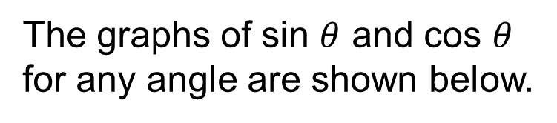

STRAND I
Unit I2
Section I2.2
sin θ , cos θ and tan θ
Some key values of sin $θ$ , cos $θ$ and tan $θ$ are shown below.
$θ$ sin $θ$ cos $θ$ tan $θ$
0° 0 1 0
30° $\frac{1}{2}$ $\frac{\sqrt{3}}{2}$ $\frac{1}{\sqrt{3}}$
45° $\frac{1}{\sqrt{2}}$ $\frac{1}{\sqrt{2}} 1$
60° $\frac{\sqrt{3}}{2}$ $\frac{1}{2}$ $\sqrt{3}$
90° 1 0 infinite
The graphs of sin $θ$ and cos $θ$ for any angle are shown below.
The graphs are examples of periodic functions. The graph repeats every 360$°.$ (The period is 360$°$)

Slide 13
STRAND I
Unit I2
Section I2.2
Sine and Cosine Rules
Example
An oil tanker leaves Town X, and travels on a bearing of 050$°$ to Town Z,
50 km away.
The tanker then travels to Town Y, 70 km away, on a bearing of 120$°$.
a) Find the distance of Y from X, giving your answer to 3 sig. figs.
Solution
In triangle XZY, angle XZY = 50$°$+ 60$°$ =110$°$ so, using the cosine rule
${\text{XY}}^{2}$ = ${\text{50}}^{2}$ + ${\text{70}}^{2}$ − 2 × 50 ×70 × cos 110°
= 2500 + 4900 − 7000 cos 110°
≈ 7400 − 7000 × (− 0.3420) = 9794
XY ≈ 98.965 = 99.0 to 3 sig. figs.

Slide 14
STRAND I
Unit I2
Section I2.2
Sine and Cosine Rules
Example (continued)
b) Calculate the bearing of X from Y, giving your answer to the nearest degree
Solution
We need to find the angle ZYX to determine the bearing of X from Y. In triangle ZYX, using the sine rule,
So sin ZYX ≈ 0.4748 giving angle ZYX ≈ 28.34$°$= 28$°$ to the nearest degree
Hence the bearing of X from Y = 360$°$ − ( 60$°$+ 28$°$) = 272$°$
$$\frac{\sin{ZYX}}{50}=\frac{sin 110°}{99}$$

Slide 15
STRAND I
Unit I2
Section I2.2
Sine and Cosine Rules
Example
Find the shaded angle in the
triangle shown, giving your answer to one decimal place.
Solution
Using the cosine rule,
${25}^{2}$ = ${\text{16}}^{2}$ + ${\text{13}}^{2}$ − 2 ×16 ×13 × cos x
Rearranging:
2 ×16 ×13 × cos x = ${\text{16}}^{2}$ + ${\text{13}}^{2}$ − ${25}^{2}$
416 × cos x = −200
So cos x = $\frac{−25}{52}$
and using the SHIFT and COS buttons on a calculator:
x =$\cos^{−1}$($\frac{−25}{52}$) = 118.7$°$ (to 1decimal place)

Slide 16
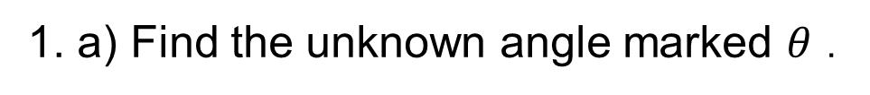
STRAND I
Unit I2
Section I2.2
Section I2.2: Fitness Check
Here are some questions to check your progress
1. a) Find the unknown angle marked $θ$ .
Answer
$$\frac{\sin{Θ}}{8.1}=\frac{sin85°}{10.3}$$
$\text{giving} Θ$ = 51.6 °(1 d.p.)
b) Find the unknown side marked a.
Answer
$$\frac{\sin{60°}}{5}=\frac{sin70°}{a}$$
giving a = 5.43 9 (2 d.p.)

Slide 17
STRAND I
Unit I2
Section I2.2
Section I2.2: Fitness Check
Here are some questions to check your progress
3. Find the unknown angles and sides.
Answers
a = 3.278 cm,
C = 67.6$°$ (1 d.p.),
B = 52.4$°$ (1 d.p.)
4. To calculate the height of a church tower, a surveyor measures the angle of elevation of the top of the tower from two points 50 m apart.
a) Calculate the distance BC.
b) Hence calculate the height CD.
Answers
a) 24.12 m b) 32.98 m

Slide 18
STRAND I
Unit I2
Section I2.2
Section I2.2: Review
You have completed the second Section.
If you have completed and understood this section,
click to start the next Section.
If you need more examples and interactive practice, go to
http://szalonta.hu/ske/text/I2/skei2s2.html

Slide 19
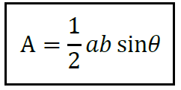
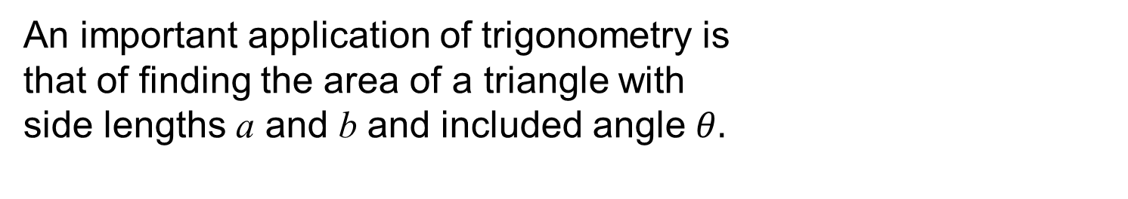
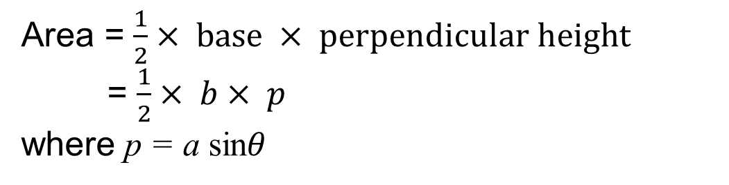
STRAND I
Unit I2
Section I2.3
Application: Area of any Triangle
An important application of trigonometry is
that of finding the area of a triangle with
side lengths a and b and included angle $θ.$
This area, A, is given by
We can prove this result by constructing the perpendicular line from point B to the line AC.
Area = $\frac{1}{2}× base × perpendicular height$
= $\frac{1}{2}× b× p$
where p = a sin$θ$
So Area = $\frac{1}{2}× b × \text{a} \text{sin}θ\text{= }\frac{1}{2} ab\sin{θ}$

Slide 20
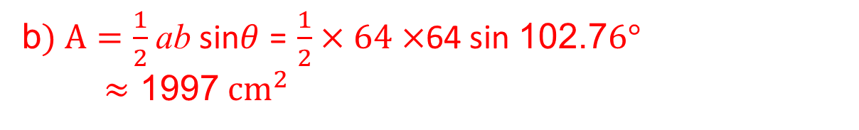
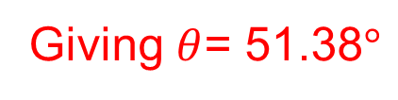
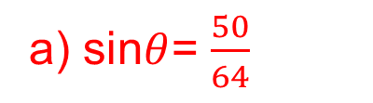
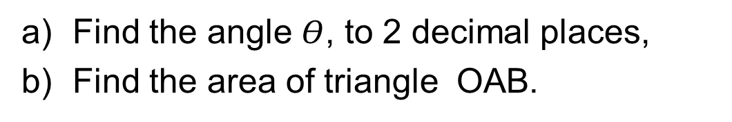
STRAND I
Unit I2
Section I2.3
Application: Area of any Triangle
Example
The diagram shows a circle of radius 64 cm. The length of the chord AB is 100 cm.
a) Find the angle $Θ$, to 2 decimal places,
b) Find the area of triangle OAB.
Solution
a) sin$θ$= $\frac{50}{64}$
Giving $θ$= 51.38$°$
b$) A=\frac{1}{2}$ ab sin$θ$ = $\frac{1}{2}×64×$64 sin 102.7$6°$
$≈$ 1997${ cm}^{2}$

Slide 21


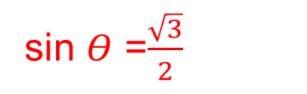


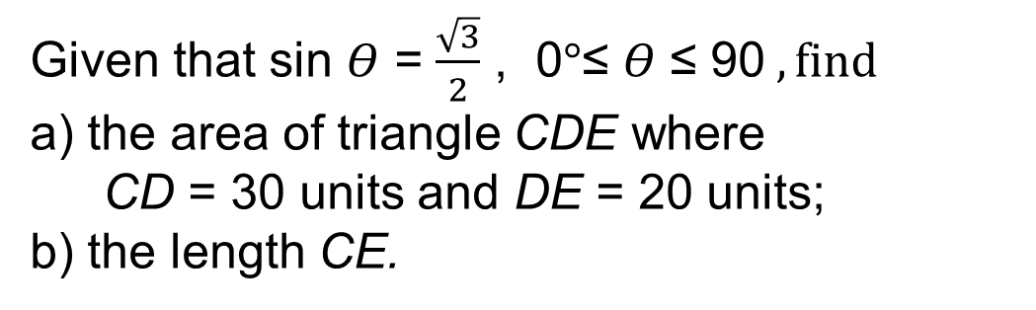

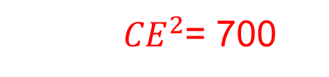

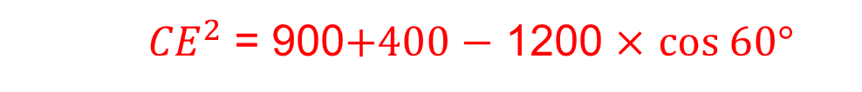
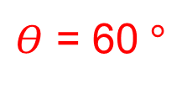

STRAND I
Unit I2
Section I2.3
Application: Area of any Triangle
Example
Given that sin $Θ$ = $\frac{\sqrt{3}}{2}$ , 0$°$≤ $Θ$ ≤ 90$, find$
a) the area of triangle CDE where
CD = 30 units and DE = 20 units;
b) the length CE.
Solution
$\text{a}\text{)} \text{Area}=\frac{1}{2}$ a b sin $Θ$ = $\frac{1}{2}× 30 ×$ 20 $×$ $\frac{\sqrt{3}}{2}$ = 150$\sqrt{3 }{cm}^{2}$
b) We first find the angle $Θ$:
sin $Θ$ =$\frac{\sqrt{3}}{2}$
sin $Θ^{−1}$($\frac{\sqrt{3}}{2}$)
$Θ$ = 60 $°$
$$⟹$$
$$⟹$$
Now we use the cosine rule to find the length CE
${ CE}^{2}$ = ${30}^{2}+ {20}^{2}$ $−$2 $×$ 30 $×$ 20 $×$ $cos\text{ 60}°$
${ CE}^{2}$ = 900$+400$ $−$ 1200 $×$ $cos\text{ 60}°$
${ CE}^{2}$= 700
$$⟹$$
$$CE=√700$$
$$CE=26.46 2 d.p.$$
$$⟹$$

Slide 22

STRAND I
Unit I2
Section I2.3
Section I2.3: Fitness Check
Here are some questions to check your progress
1. Find the area of the shaded region.
Give your answer to 2 decimal places.
Answer
${24.13 cm}^{2}$
2. Find the area of the shaded region.
Give your answer to 2 decimal places
Answer
${94.53 cm}^{2}$

Slide 23
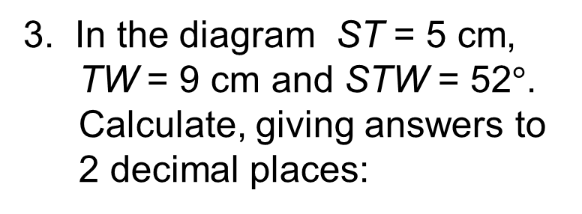
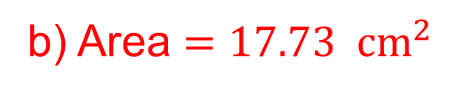
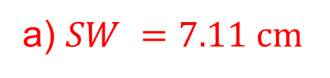
STRAND I
Unit I2
Section I2.3
Section I2.3: Fitness Check
Here are some questions to check your progress
3. In the diagram ST = 5 cm, TW = 9 cm and STW = 52$°$.
Calculate, giving answers to 2 decimal places:
a) the length of SW;
b) the area of triangle STW.
Answers
a) $SW =7.11 cm$
b) Area $=17.73{ cm}^{2}$

Slide 24
STRAND I
Unit I2
Section I2.3
Section I2.3: Review
You have completed the third Section.
If you have completed and understood this section,
click to start the next Section.
If you need more examples and interactive practice, go to
http://szalonta.hu/ske/text/I2/skei2s3.html

Slide 25
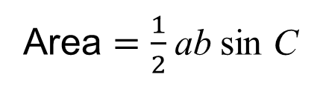
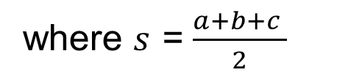
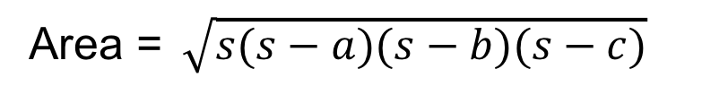
STRAND I
Unit I2
Section I2.4
Heron’s Formula
You have already met the formula for the area of a triangle when the lengths of two sides and the included angle are known:
Area $=\frac{1}{2}$ ab sin C
There is another formula for the area of a triangle when all 3 sides are given. This is credited to Heron (or Hero) of Alexandria; a proof can be found in his book, Metrica, written in about AD 60.
The formula, known as Heron's formula, is given by
Area =$\sqrt{s(s−a)(s−b)(s−c)}$
where $s$ = $\frac{a+b+c }{2}$

Slide 26
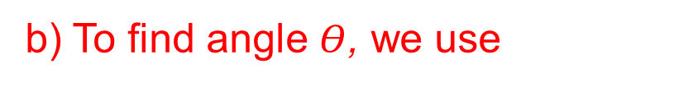

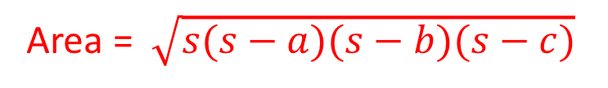
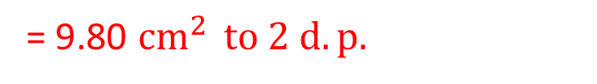
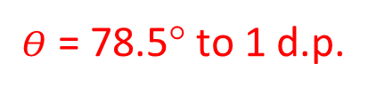
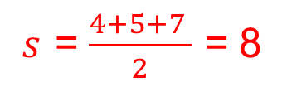
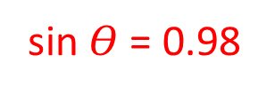

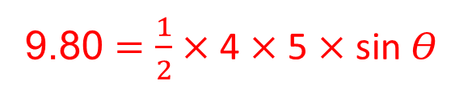
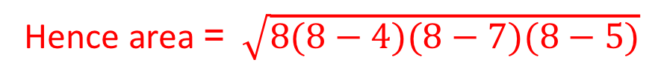
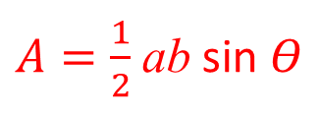

STRAND I
Unit I2
Section I2.4
Heron’s Formula
Example
For the triangle shown, find
a) the area of the triangle,
b) angle θ .
Solution
a) Using Heron's formula
Area =$\sqrt{s(s−a)(s−b)(s−c)}$
where $s$ = $\frac{a+b+c }{2}$ gives
$s$ = $\frac{4+5+7 }{2}$ = 8
Hence area =$\sqrt{8(8−4)(8−7)(8−5)}$
= 9.80 ${cm}^{2 } to 2 d.p.$
$A=\frac{1}{2}$ ab sin $Θ$
b) To find angle $Θ$, we use
9.80 $=\frac{1}{2}$ $×$ 4 $×$ 5 $×$ sin $Θ$
$$⟹$$
sin $Θ$= 0.98
$$⟹$$
$Θ$ = 78.5° to 1 d.p.

Slide 27
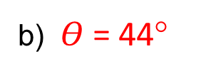
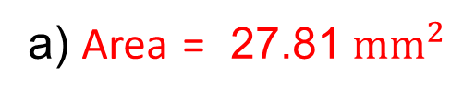
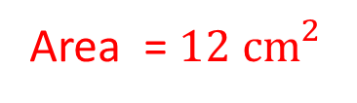
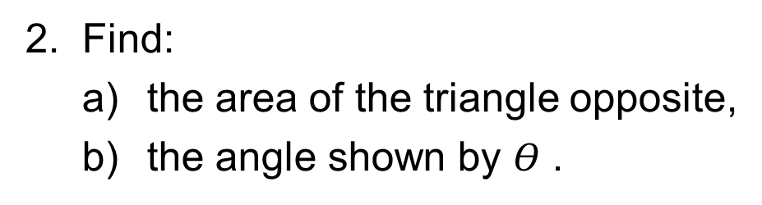
STRAND I
Unit I2
Section I2.4
Section I2.4: Fitness Check
Here are some questions to check your progress
1. Calculate this area of the triangle.
Answer
Area =${ 12 cm}^{2}$
2. Find:
a) the area of the triangle opposite,
b) the angle shown by $Θ$ .
Answers
a) Area = 27.81${ mm}^{2}$
b)$Θ$= 44°

Slide 28
STRAND I
Unit I1
Section I1.4
Section I1.4: Review
You have completed the last Section.
If you need more examples and interactive practice, go to
http://szalonta.hu/ske/text/I2/skei2s4.html

