Slide 1
Strand J
UNIT J1: Reflections, Rotations and Enlargements

Slide 2
Strand J
Unit J1
Reflections, Rotations and Enlargements
This Unit describes how shapes can be transformed by reflection,
rotation and enlargement.
You have three sections to work through and there are check up audits
and fitness tests for each section.
Reflections
Rotations
Enlargements

Slide 3
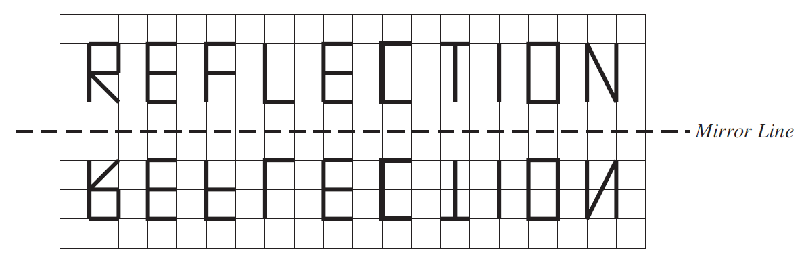
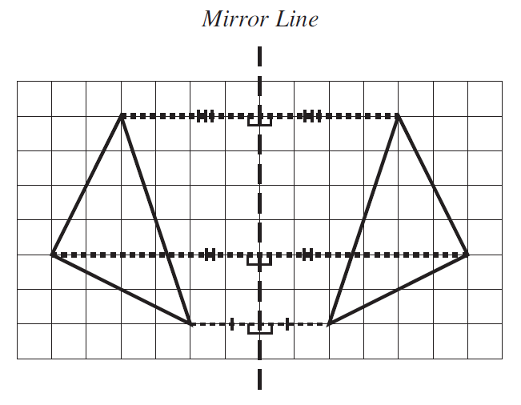
Reflections
Strand J
Unit J1
Section J1.1
Reflections are obtained when you draw the image that would be
obtained in a mirror.
Every point on a reflected image is always
the same distance from the mirror line as
the original. This is shown on the right.
Note:
Distances are always measured at
right angles to the mirror line.

Slide 4
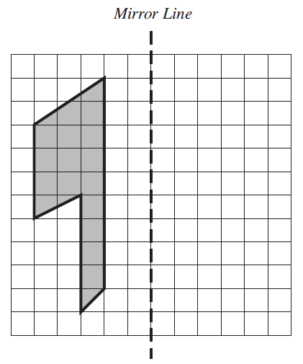
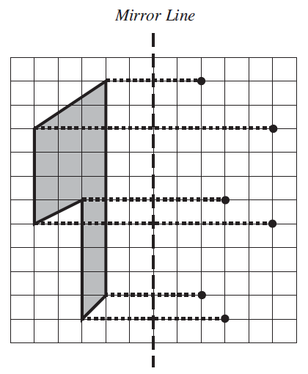
Reflections: Examples
Strand J
Unit J1
Section J1.1
Example 1
Draw the reflection of the shape in the mirror line shown.
Solution
The lines added to the diagram below show how to find the position of each point after it has been reflected.
Remember that the
image of each point
is the same distance
from the mirror line as
the original.
Continued on next slide

Slide 5
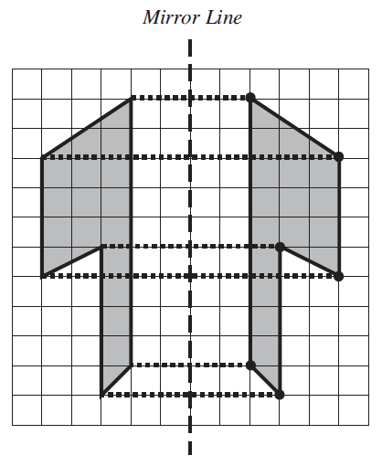
Strand J
Unit J1
Section J1.1
Reflections: Examples
Solution (continued)
The position of each point after it has been reflected show how to draw the reflected shape.
The points can then be joined to give
the reflected image.
If the construction lines have been drawn in pencil they can be rubbed out.

Slide 6
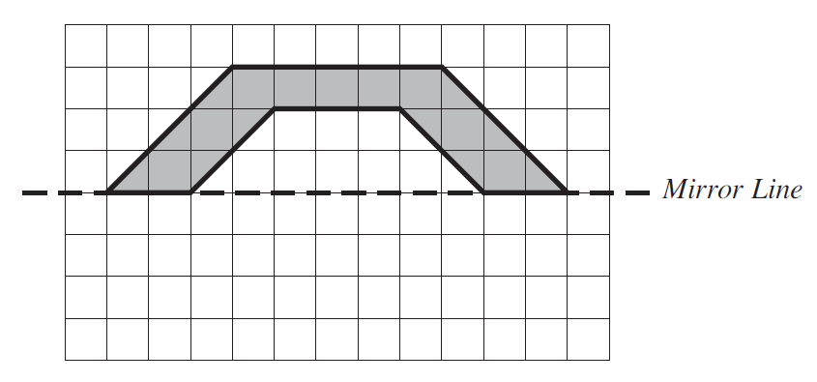
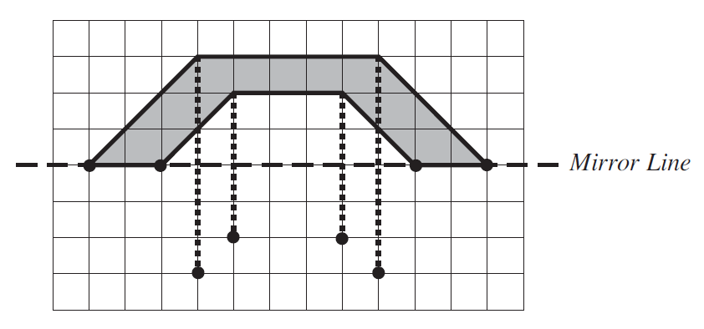
Reflections: Examples
Strand J
Unit J1
Section J1.1
Example 2
Reflect this shape in the mirror line shown in the diagram.
Solution
The lines are drawn at
right angles to the mirror
line.
The points which form the image must be the same distance from the mirror lines as the original points. The points which were on the mirror line remain there.
Continued on next slide

Slide 7

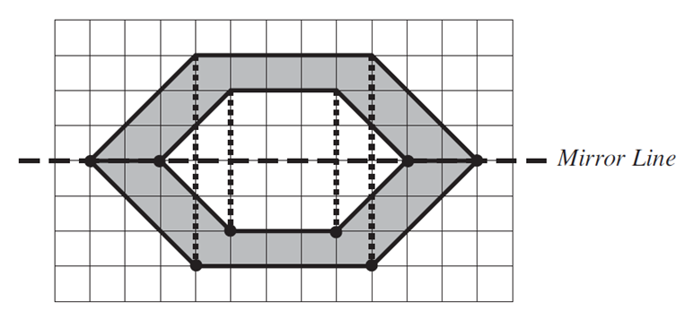
Strand J
Unit J1
Section J1.1
Reflections: Examples
Solution (continued)
The points can then be joined to give the reflected image.
The final image is shown on the right.

Slide 8
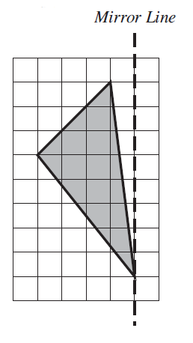
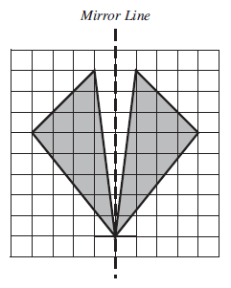
Section J1.1: Fitness Check
Strand J
Unit J1
Section J1.1
Here are some questions to check your progress; there are more practice questions if needed.
1. Copy this diagram and draw its reflection in the mirror line
Answer

Slide 9
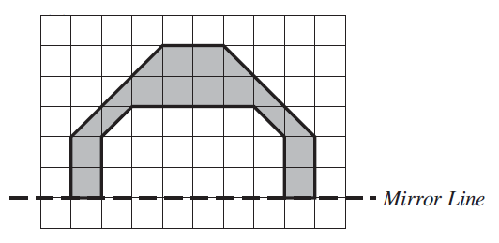
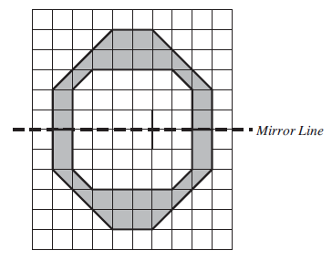
Strand J
Unit J1
Section J1.1
Section J1.1: Fitness Check
Here are some questions to check your progress; there are more practice questions if needed.
2. Copy this diagram and draw its reflection in the mirror line
Answer

Slide 10
STRAND J
Unit J1
Section J1.1
Section J1.1: Review
You have completed the first Section.
If you have completed and understood this section,
click to start the next Section.
If you need more examples and interactive practice, go to
http://szalonta.hu/ske/text/J1/skej1s1.html

Slide 11
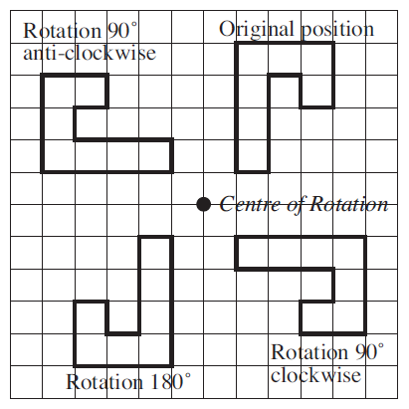
STRAND J
Unit J1
Section J1.2
Rotations
Rotations are obtained when a shape is rotated about a fixed point, called the centre of rotation, through a specified angle. The diagram shows a number of rotations.
It is often helpful to use tracing paper to find the position of a shape after a rotation.

Slide 12
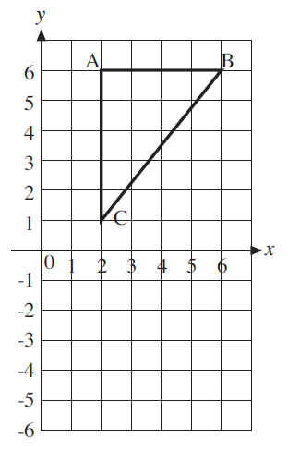
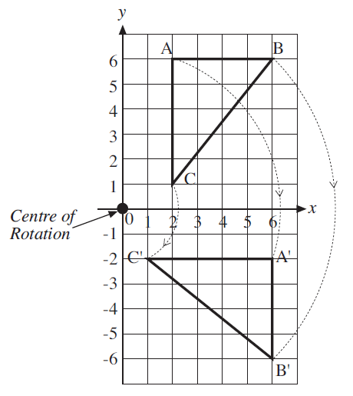
STRAND J
Unit J1
Section J1.2
Rotations
Example 1
Rotate the triangle ABC shown in the diagram through 90 ̊ clockwise about the point with coordinates (0, 0).
Solution
The diagram shows how each vertex can be rotated through 90 ̊ to give the position of the new triangle.

Slide 13
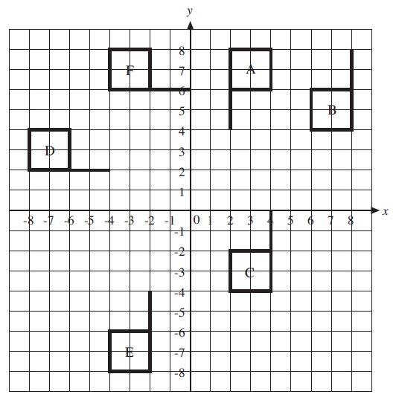
STRAND J
Unit J1
Section J1.2
Rotations
Example 2
The diagram shows the position of a shape A and the shapes, B, C, D, E and F which are obtained from A by rotation.
Describe the rotation which moves A onto each other shape.
You need to find both the centre of rotation and the angle of rotation for each example.

Slide 14
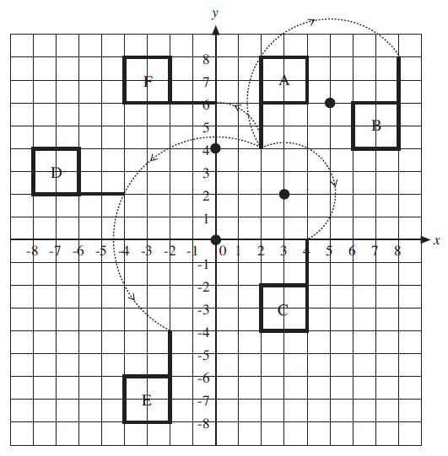
STRAND J
Unit J1
Section J1.2
Rotations
Solution
The diagram shows the centres of rotation and how one vertex of the shape A was rotated.
A to B: Rotation of 180 ̊ about the point (5, 6).
A to C: Rotation of 180 ̊ about the point (3, 2).
A to D: Rotation of 90 ̊ anti-clockwise about the point (0, 0).
A to E: Rotation of 180 ̊ about the point (0, 0).
A to F: Rotation of 90 ̊ anti-clockwise about the point (0, 4).

Slide 15
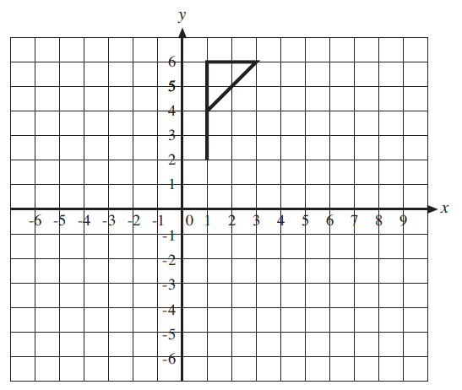
STRAND J
Unit J1
Section J1.2
Section J1.2: Fitness Check
Here are some questions to check your progress; there are more practice questions if needed.
1. Copy the axes and shape shown below.
a) Rotate the original shape through 90 ̊ clockwise around the point (1, 2).
b) Rotate the original shape through 180 ̊ around the point (3, 4).
c) Rotate the original shape through 90 ̊ clockwise around the point (1, −2).
d) Rotate the original shape through 90 ̊ anti-clockwise around the point (0, 1).
Answers on next slide

Slide 16
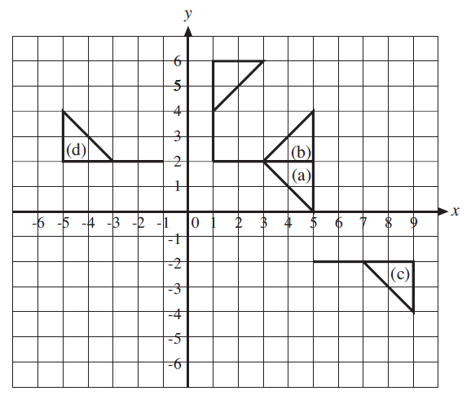
STRAND J
Unit J1
Section J1.2
Section J1.2: Fitness Check
Answers
The rotated shapes are shown on the left.

Slide 17
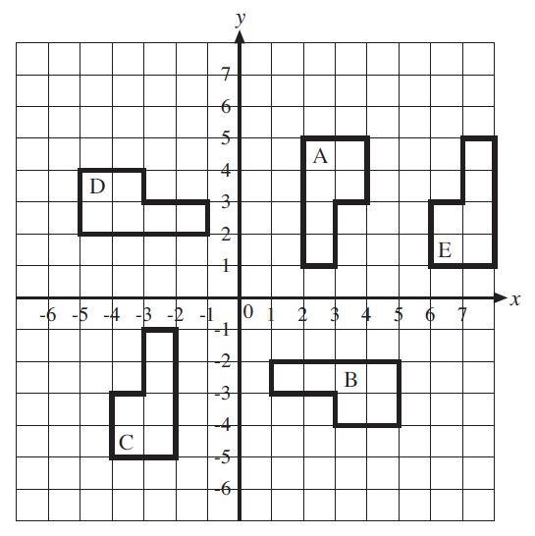
STRAND J
Unit J1
Section J1.2
Section J1.2: Fitness Check
2. The diagram shows the position of a shape labelled A and other shapes which were obtained by rotating A.
Describe how each shape can be obtained from A by a rotation.
b) Which shapes can be obtained by rotating the shape E?

Slide 18
STRAND J
Unit J1
Section J1.2
Section J1.2: Fitness Check
Answers
a) A to B: 90 ̊ rotation, clockwise, centre (0, 0)
A to C: 180 ̊ rotation, centre (0, 0)
A to D: 90 ̊ rotation, anticlockwise, centre (0, 0)
A to E: 180 ̊ rotation, centre (5, 3)
b) A, B and D

Slide 19
STRAND J
Unit J1
Section J1.2
Section J1.2: Review
You have completed the second Section.
If you have completed and understood this section,
click to start the next Section.
If you need more examples and interactive practice, go to
http://szalonta.hu/ske/text/J1/skej1s2.html

Slide 20
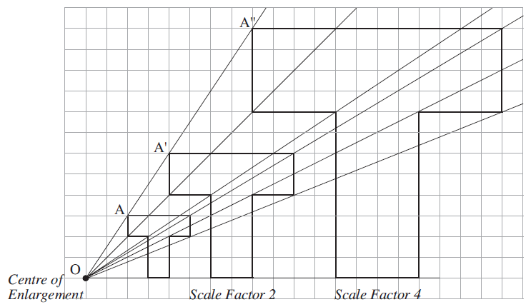
STRAND J
Unit J1
Section J1.3
Enlargements
An enlargement is a transformation which enlarges (or reduces) the size of an image. Each enlargement is described in terms of a centre of enlargement and a scale factor.
The example shows how the original, A, was enlarged with scale factors 2 and 4. A line from the centre of enlargement passes through the corresponding vertex of each image.

Slide 21
STRAND J
Unit J1
Section J1.3
Enlargements
Note:
The distances, OA′ and OA′′, are related to OA:
OA′ = 2 × OA
OA′′ = 4 × OA
The same is true of all the other distances between O and corresponding points on the images.

Slide 22
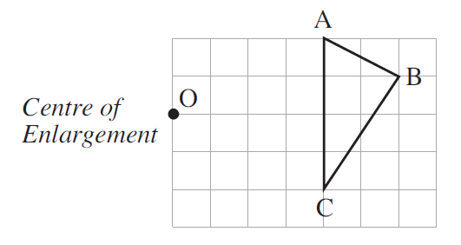
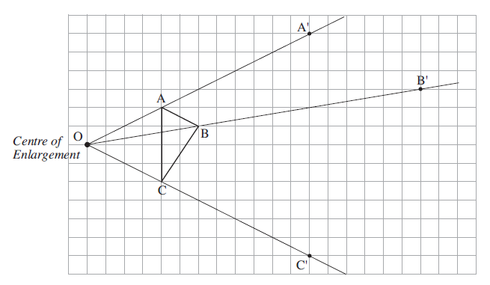
STRAND J
Unit J1
Section J1.3
Enlargements: Examples
Example 1
Enlarge the triangle shown using the centre of enlargement marked and scale factor 3.
Solution
The first step is to draw lines from the centre of enlargement through each vertex of the triangle as shown on the right.
Continued on next slide

Slide 23
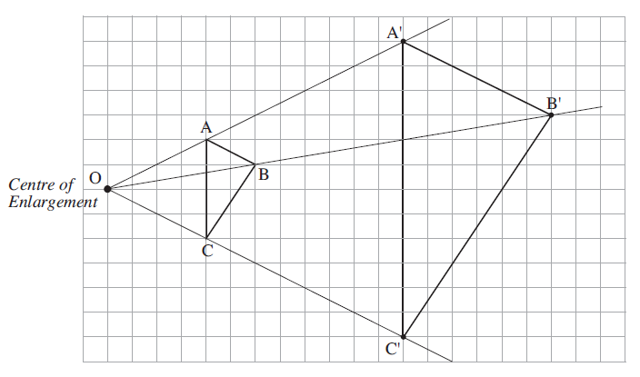
STRAND J
Unit J1
Section J1.3
Enlargements: Examples
Solution (continued)
As the scale factor is 3, then the distances from the centre of enlargement to the vertices of the
image will be:
OA′ = 3 × OA
OB′ = 3 × OB
OC′ = 3 × OC
The points A′, B′ and C′ have also been marked on the diagram. Once these points have been found they can be used to draw the enlarged triangle.

Slide 24
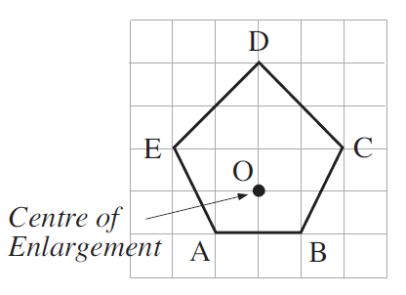
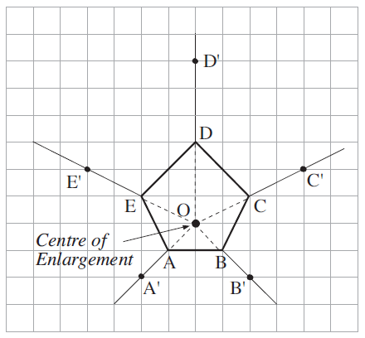
STRAND J
Unit J1
Section J1.3
Enlargements: Examples
Example 2
Enlarge the pentagon with scale factor 2 using the centre of enlargement marked on the diagram.
Solution
The first step is to draw lines from the centre of enlargement which pass through the five vertices of the pentagon.
Continued on next slide

Slide 25
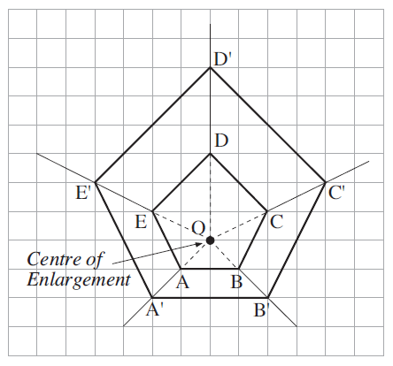
STRAND J
Unit J1
Section J1.3
Enlargements: Examples
Solution (continued)
As the scale factor is 2, then the distances from the centre of enlargement to the vertices of the
image will be:
OA′ = 2 × OA
OB′ = 2 × OB
OC′ = 2 × OC
OD′ = 2 × OD
OE′ = 2 × OE
These points can then be marked and joined to give the enlargement.

Slide 26
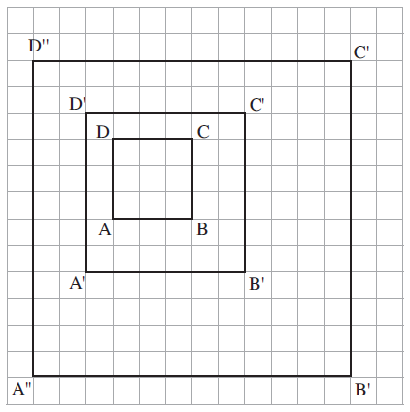
STRAND J
Unit J1
Section J1.3
Enlargements: Examples
Example 3
The diagram shows the square ABCD which has been enlarged to give the squares A′ B′ C′ D′ and A′′ B′′ C′′ D′′ .
Find the centre of enlargement.
Find the scale factor for each enlargement.
Continued on next slide

Slide 27
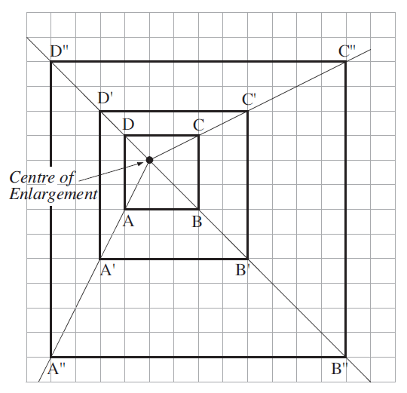
Enlargements: Examples
STRAND J
Unit J1
Section J1.3
Solution
a) To find the centre of enlargement draw lines through A, A′ and A′′ , then repeat for B, B′ and B′′ , C, C′ and C′′ and D, D′ and D′′.
These lines cross at the centre of enlargement as shown in the diagram.
Continued on next slide

Slide 28
STRAND J
Unit J1
Section J1.3
Enlargements: Examples
Solution (continued)
The sides of the square ABCD are each 3 units. The sides of the square A′ B′ C′ D′ are 6 units. As these are twice as long as the original, the scale factor for this enlargement is 2.
The sides of the square
A′′ B′′ C′′ D′′ are 12 units, which is 4 times longer than the original square. So the scale factor for this enlargement is 4.

Slide 29
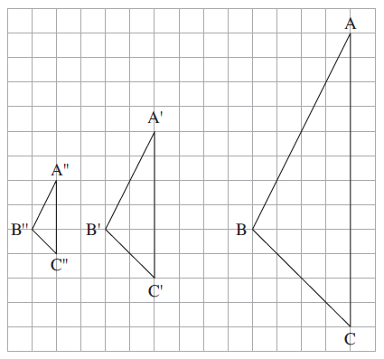
STRAND J
Unit J1
Section J1.3
Fractional Scale Factors
When the scale factor of an enlargement is a fraction, the size of the enlargement can be reduced.
The image of the original is then between the centre of enlargement and the original.
Example 4
The diagram shows three triangles. ABC was enlarged
with different scale factors to give A′ B′ C′ and A′′ B′′ C′′.
Find the centre of enlargement.
Find the scale factor for each enlargement.
Continued on next slide

Slide 30
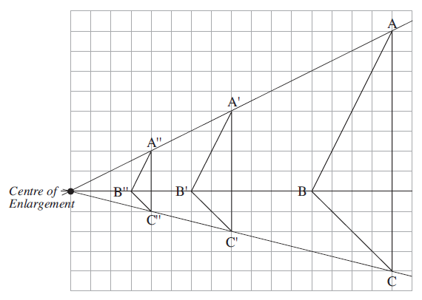
STRAND J
Unit J1
Section J1.3
Enlargements: Examples
Solution
a) To find the centre of enlargement, lines should be drawn through the corresponding points on each figure.
Continued on
next slide

Slide 31
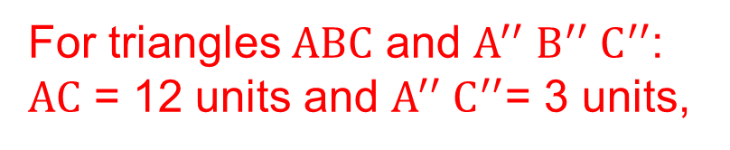
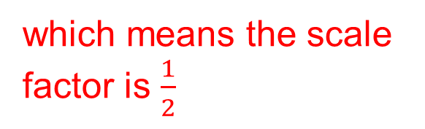


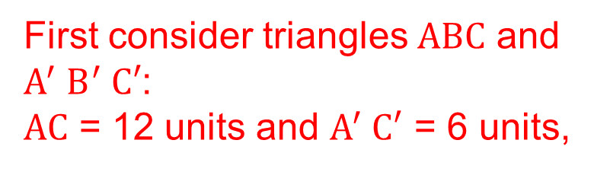
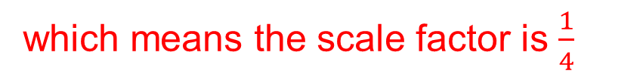
STRAND J
Unit J1
Section J1.3
Enlargements: Examples
Solution (continued)
b) To find the scale factors, compare the lengths of sides in the different triangles.
First consider triangles $ABC$ and $A^{′}{ B}^{′} C′$:
$AC$ = 12 units and $A^{′} C′$ = 6 units,
$$A^{′} C′=\frac{1}{2}×AC$$
which means the scale factor is $\frac{1}{2}$
For triangles $ABC$ and $A^{′′}{{ B}^{′′} C}^{′′}$:
$AC$ = 12 units and $A^{′′}{ C}^{′′}$= 3 units,
$$A^{′′}{ C}^{′′}=\frac{1}{4}×AC$$
which means the scale factor is $\frac{1}{4}$

Slide 32
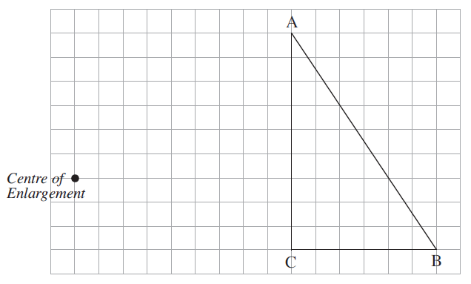

STRAND J
Unit J1
Section J1.3
Enlargements: Examples
Example 5
Enlarge the triangle shown with scale factor $\frac{1}{4}$ and centre of
enlargement as shown.
Continued on next slide

Slide 33
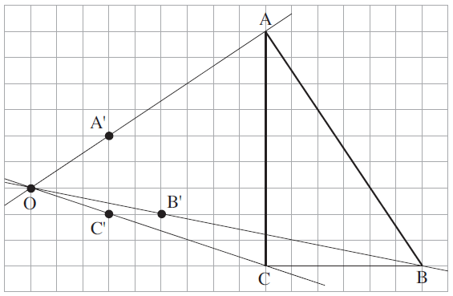
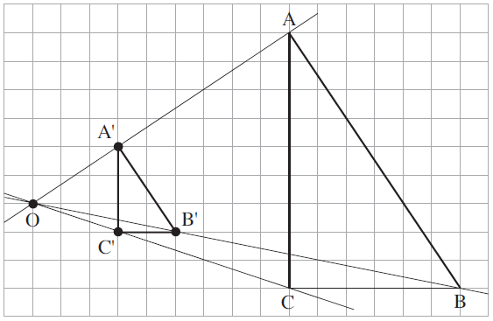
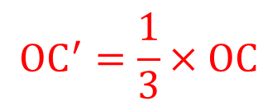

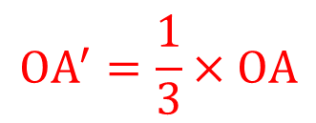
STRAND J
Unit J1
Section J1.3
Enlargements: Examples
Solution
The first stage is to draw lines from each corner of the triangle through the centre of enlargement.
These lines cross at the centre of enlargement as shown in the diagram.
Then the corners of the image should be fixed so that:
$$OA^{′}=\frac{1}{3}×OA$$
$$OB^{′}=\frac{1}{3}×OB$$
$$OC^{′}=\frac{1}{3}×OC$$

Slide 34
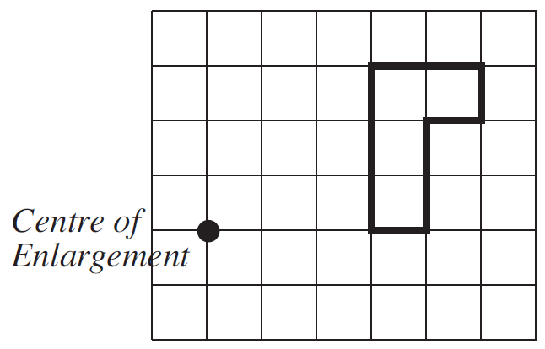
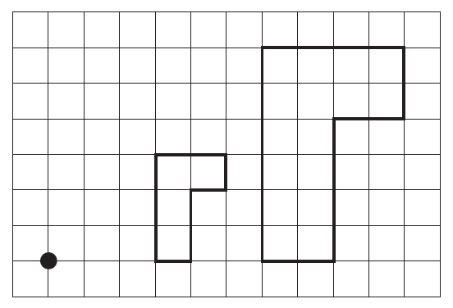
STRAND J
Unit J1
Section J1.3
Section J1.3: Fitness Check
Here are some questions to check your progress; there are more practice questions if needed.
1. Enlarge the shape with scale factor 2 using the point marked as the centre of enlargement.
Answer

Slide 35
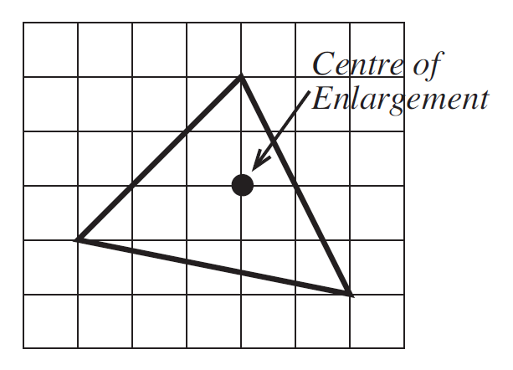
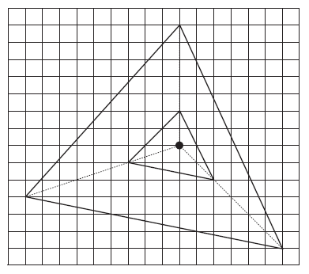
STRAND J
Unit J1
Section J1.3
Section J1.3: Fitness Check
2. Enlarge the triangle shown with scale factor 3 and the centre of enlargement shown.
Answer

Slide 36
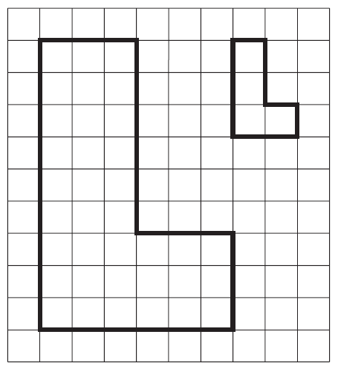
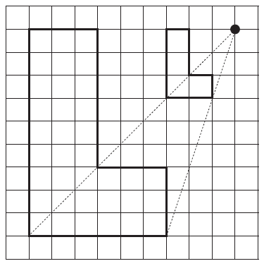
STRAND J
Unit J1
Section J1.3
Section J1.3: Fitness Check
3. For the diagram find the centre of enlargement and the scale factor when the smaller shape is enlarged to give the bigger shape.
Answer
The centre of enlargement is shown on the diagram below. The scale factor is 3.

Slide 37
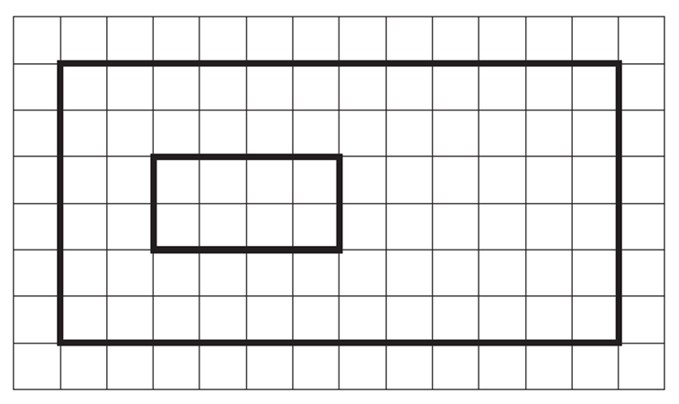
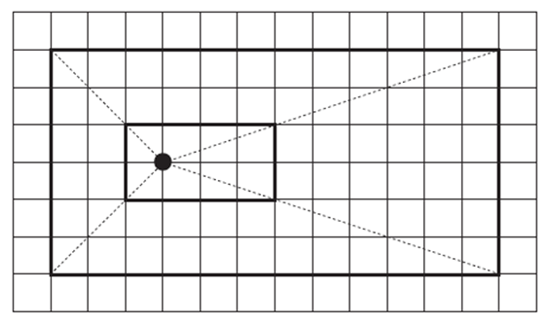
STRAND J
Unit J1
Section J1.3
Section J1.3: Fitness Check
4. For the diagram find the centre of enlargement and the scale factor when the smaller shape is enlarged to give the bigger shape.
Answer
The centre of enlargement is shown on the diagram below. The scale factor is 2.

Slide 38
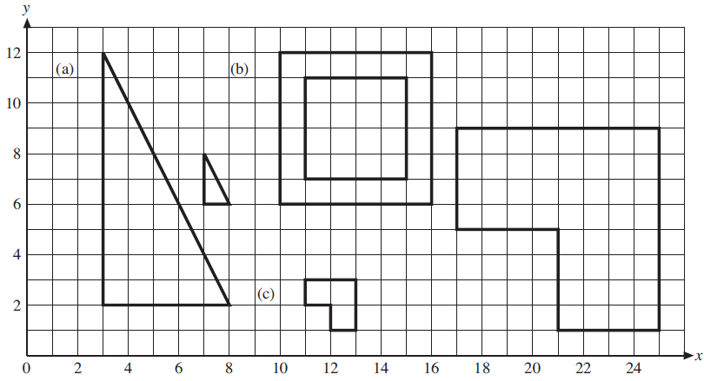
STRAND J
Unit J1
Section J1.3
Section J1.3: Fitness Check
5. In each example below, the smaller shape has been obtained from the larger shape by an enlargement. For each example, state the scale factor and the coordinates of the centre of enlargement.
Answers
a) $\frac{1}{5}$, (8, 7) b) $\frac{2}{3}$ , (13, 9) c) $\frac{1}{4}$ , (9, 1)

Slide 39
STRAND J
Unit J1
Section J1.3
Section J1.3: Review
You have completed the last Section.
If you need more examples and interactive practice, go to
http://szalonta.hu/ske/text/J1/skej1s3.html

